Slide 1


Superstore Sales Analysis
Presented by -Pinky Bhansali

Slide 2
Problem Statement
The Superstore dataset provides information/details about sales and profit data for a variety of products sold across different categories and regions.
• The goal of this project is to analyze the data and identify insights that can help the company improve its business performance.

Slide 3
Our Mission
we hope to provide recommendations for the company on how to optimize its product offerings and improve its revenue and profitability by answering certain questions such as:
Which product categories are the most profitable?
Which regions have the highest sales and profit?
What are the most profitable products

Slide 4
Data Preprocessing
The superstore dataset contains a representative sample of all transactions conducted by the store during the time period covered by the dataset.
There were no duplicate entries found in the data
The missing data in the superstore dataset is cleaned and pre-processed prior to analysis.
The superstore dataset covers a sufficient time period to allow for the identification of trends or patterns in sales and profitability.
The dataset is not impacted by any significant outliers or anomalies that could skew the results of any analysis conducted on the dataset.

Slide 5
Research Questions
Which product categories have the highest profit margins in the Super Store?
Are there any significant differences in sales between the regions?
How do sales vary during different months of the year ?
What is the rate of returned orders with same-day shipping compared to other shipping options?
Is there any impact on sales and profit vary in weekdays compared to weekends?

Slide 6
Formulate Hypothesis
Hypothesis 1: Technology products have the highest profit margin compared to other product categories.
Hypothesis 2: The East region has the highest sales compared to other regions.
Hypothesis 3: Sales are higher during certain months of the year.
Hypothesis 4: Orders with same-day shipping have the lowest rate of returned products.
Hypothesis 5: The Company’s profit is more on weekdays than on weekends.

Slide 7
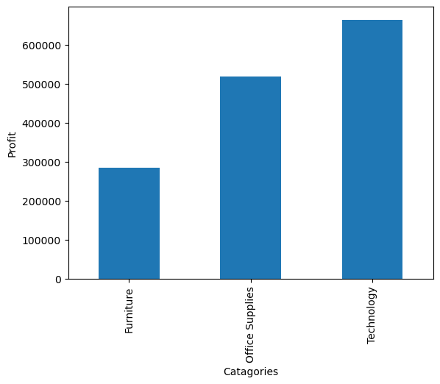
Test Hypotheses.
Hypothesis 1: Technology products have the highest profit margin compared to other product categories.
The hypothesis is supported as technology products have the highest profit margin compared to furniture and office supplies.

Slide 8
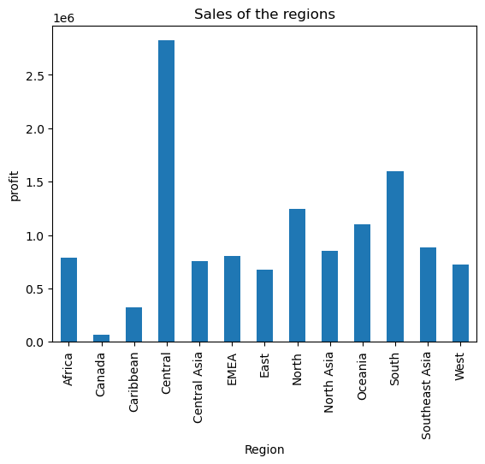
Test Hypotheses
Hypothesis 2: The East region has the highest sales compared to other regions
The hypothesis is not supported as the Central region has the highest sales as compared to other regions

Slide 9
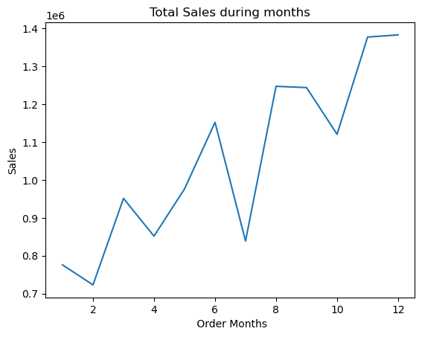
Test Hypotheses
Hypothesis 3: Sales are higher during certain months of the year
As we see the Sales are higher in November and December.
This supports our hypothesis that sales are higher during certain months of the year.

Slide 10
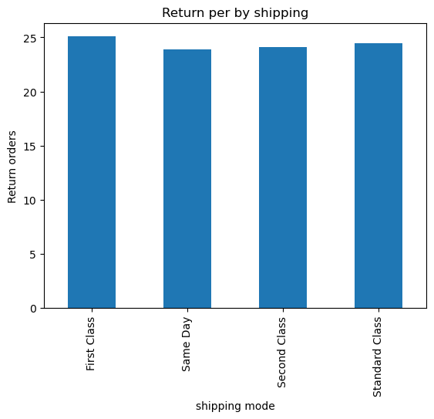
Test Hypotheses
Hypothesis 4: Orders with same-day shipping have the lowest rate of returned products.
The hypothesis is supported as orders with same-day shipping have the lowest rate of returned products

Slide 11
Test Hypotheses
Hypothesis 5: The company's profit is more on weekdays than on weekends.
The hypothesis is supported as the company's profit is higher on weekdays compared to weekends.

Slide 12

Conclusion
These conclusions provide valuable insights into the company's performance and can guide future decision-making processes.
Based on the analysis, it can be concluded that technology products have the highest profit margin compared to other product categories.
The company's profit is higher on weekdays than on weekends.
Sales are higher during November and December months of the year.
Orders with same-day shipping have the lowest rate of returned products.
The hypothesis that the East region has the highest sales compared to other regions is not supported by the data.

Slide 13

Suggestions
The company should focus on promoting furniture and office supplies products to increase its sales. Or they could also consider reducing the production and promotion of these products with lower profit margins and focus on promoting technology products which has highest sales.
Central region has the highest sales compared to other regions; the company could consider increasing its focus on this region and re-evaluate its marketing and sales strategies in other regions.
The company should focus on maximizing the production by increasing the inventory of popular products during the months of November and December. They can also run targeted marketing campaigns, offering promotions or discounts to customers. However, the company should also consider strategies to increase sales during other months, by introducing new products or services or offering promotions and discounts during slower months.

Slide 14
Suggestions
The company could consider offering more same-day shipping options to customers. This might involve optimizing inventory and supply chain processes to ensure that products can be shipped quickly and efficiently.
The company could consider focusing on different types of promotions or sales during the weekends to increase sales.
For example:
the company could offer weekend-only promotions or discounts or run targeted marketing campaigns
The company could arrange special events or activities in-store on weekends to attract customers and increase sales.
the company could focus on offering products and services that are particularly popular among weekend shoppers, such as home entertainment or outdoor product.

